Slide 1

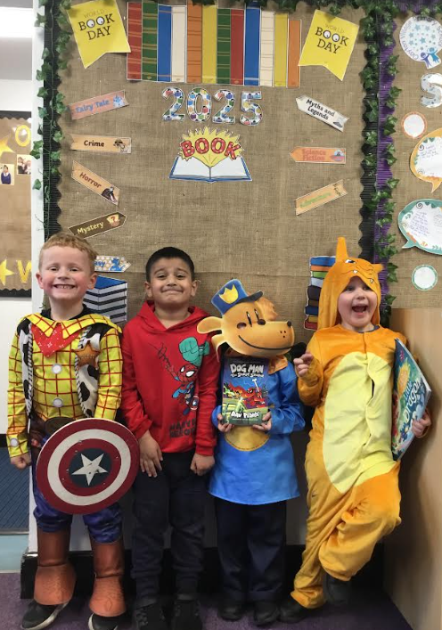

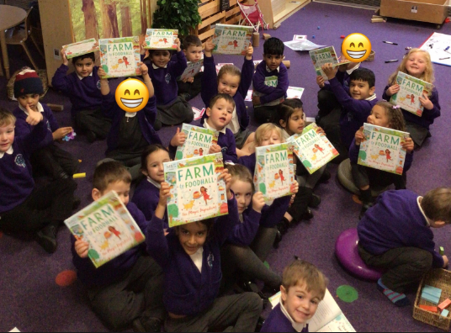

WELCOME TO CVPS

Slide 2
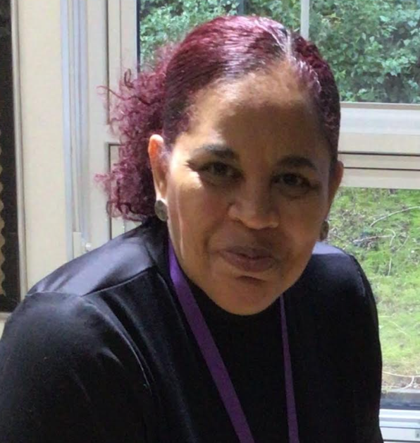
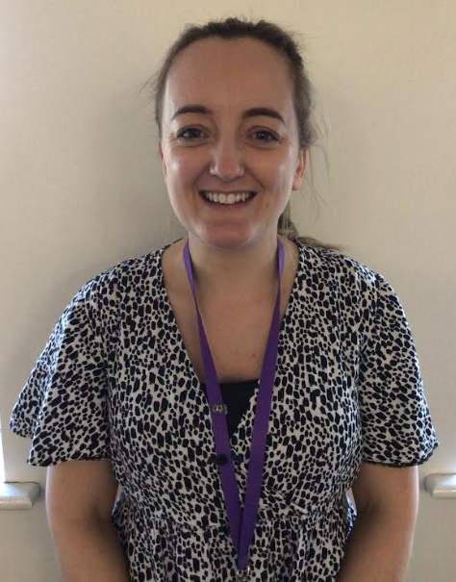
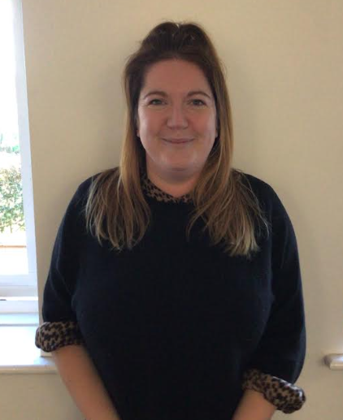
STAFF – SENIOR LEADERS
Mrs Rahim
Headteacher
Mrs Whitaker
T+L leader
Miss Needham
SENDCo

Slide 3
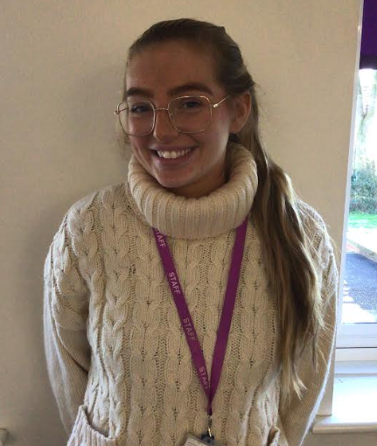
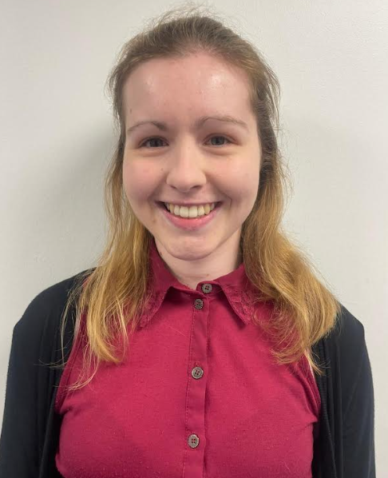
STAFF – RECEPTION TEAM
Miss Robinson
Class teacher
Miss Stokes
Teaching assistant

Slide 4
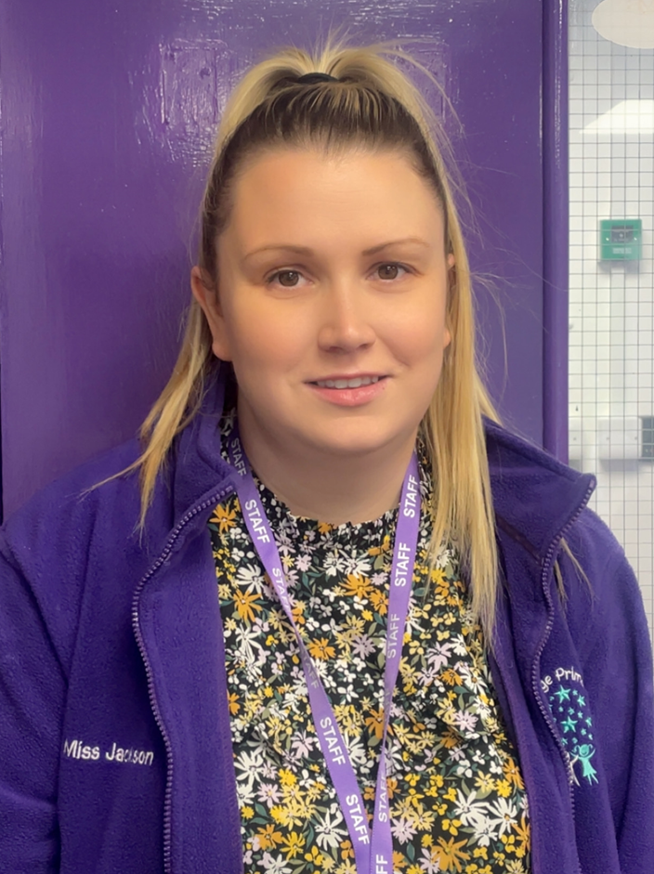
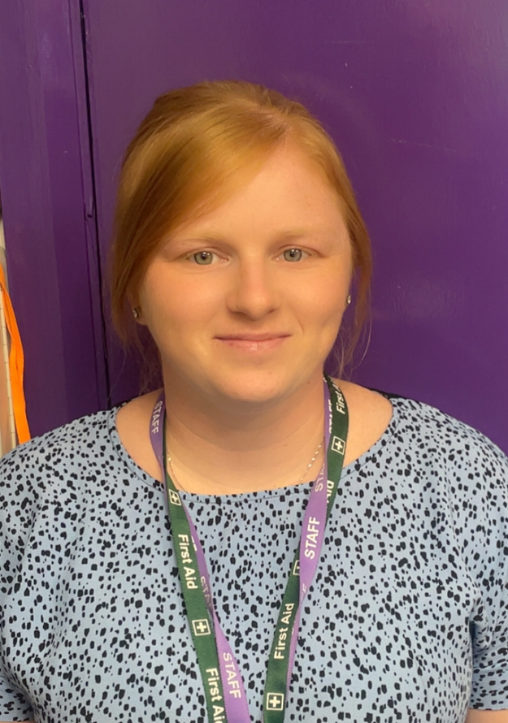
STAFF - OFFICE
Miss Jackson
Mrs Mairs

Slide 5

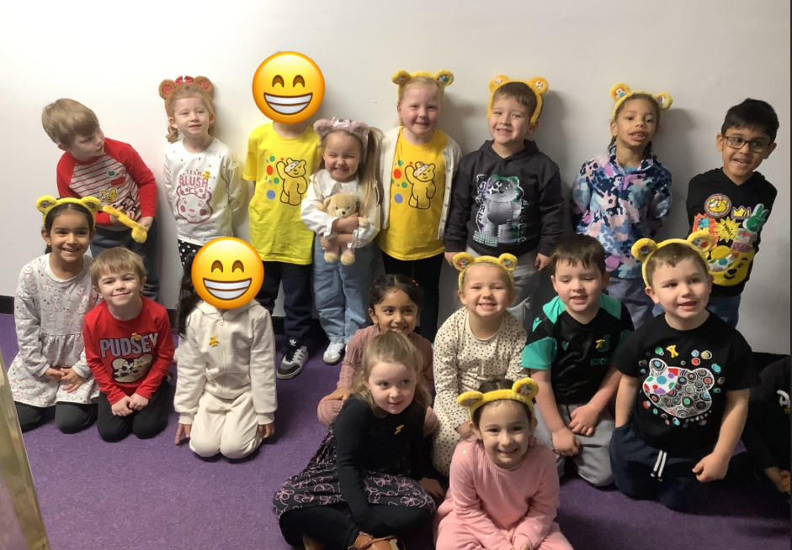
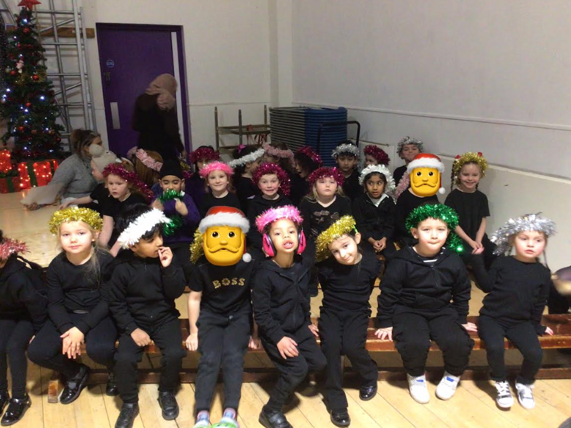
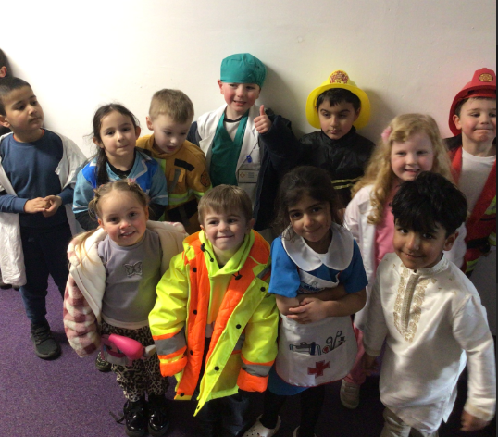
A DAY IN RECEPTION

Slide 6


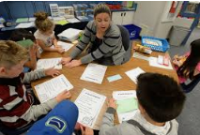









Slide 7
ALL ABOUT ME

Slide 8
SEESAW

Slide 9
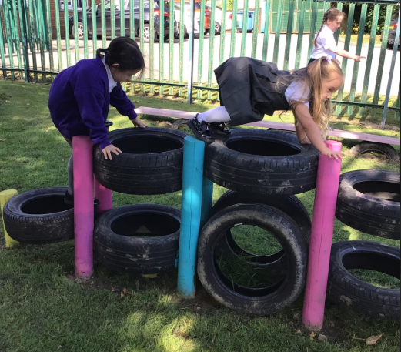
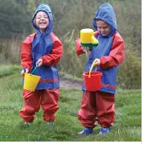
OUTDOOR LEARNING
Outdoor learning is focuses on learning through exploration, play, and discovery in natural environments. It provides children with the opportunity to engage with the great outdoors on a daily basis. There are wide ranging benefits of outdoor learning for children. These include: Connection with Nature, Physical Development, Emotional Well-being, Social Skills, Creativity and Imagination and Resilience and Risk Management
We embrace outdoor learning as part of the curriculum. It can have a profound and lasting impact on their physical, emotional, social, and cognitive development. We provide regular opportunities for outdoor exploration and play in natural environments, helping to nurture a lifelong love of nature and a strong foundation for future learning and growth.

Slide 10
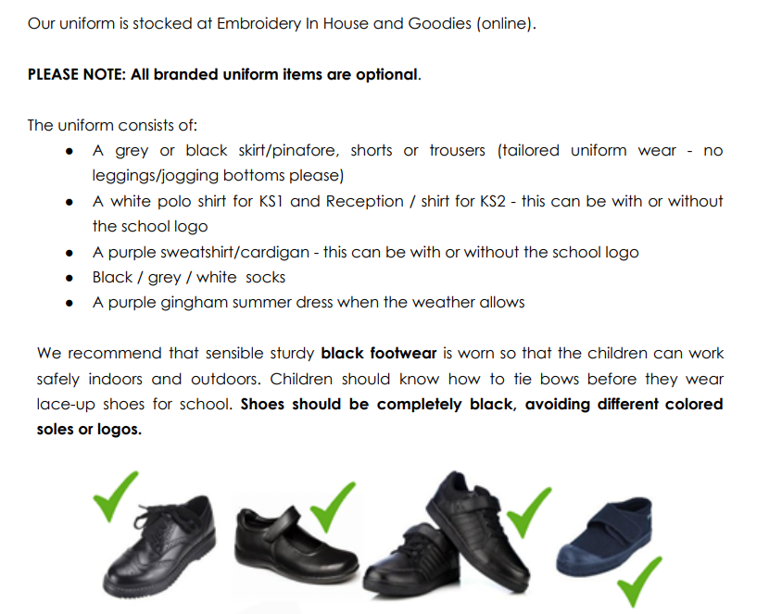
UNIFORM

Slide 11
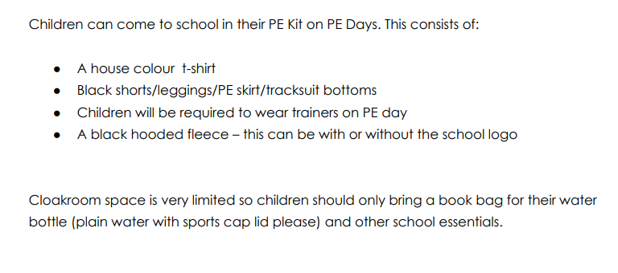

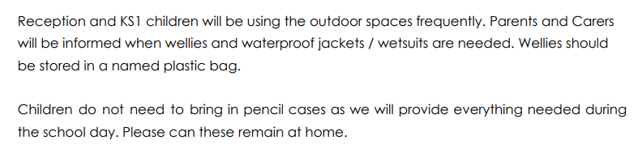
UNIFORM

Slide 12
PE

Slide 13
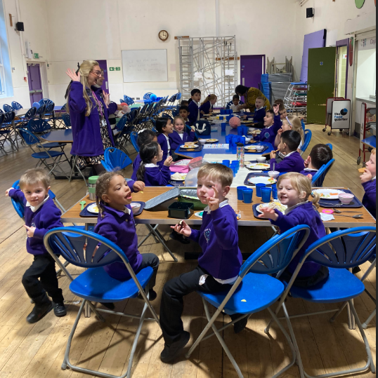
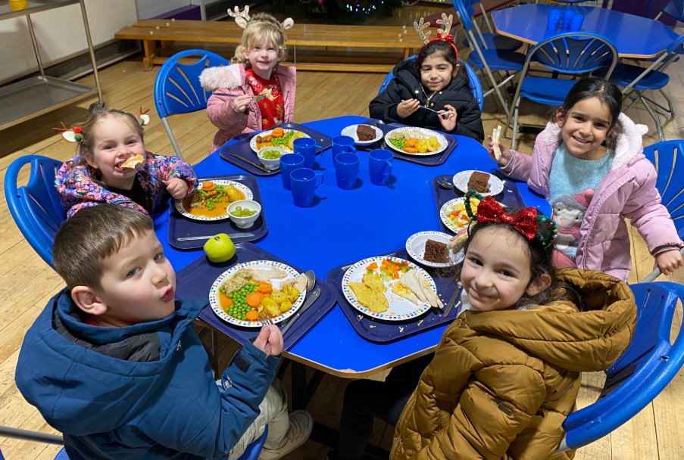
BEING SCHOOL READY

Slide 14
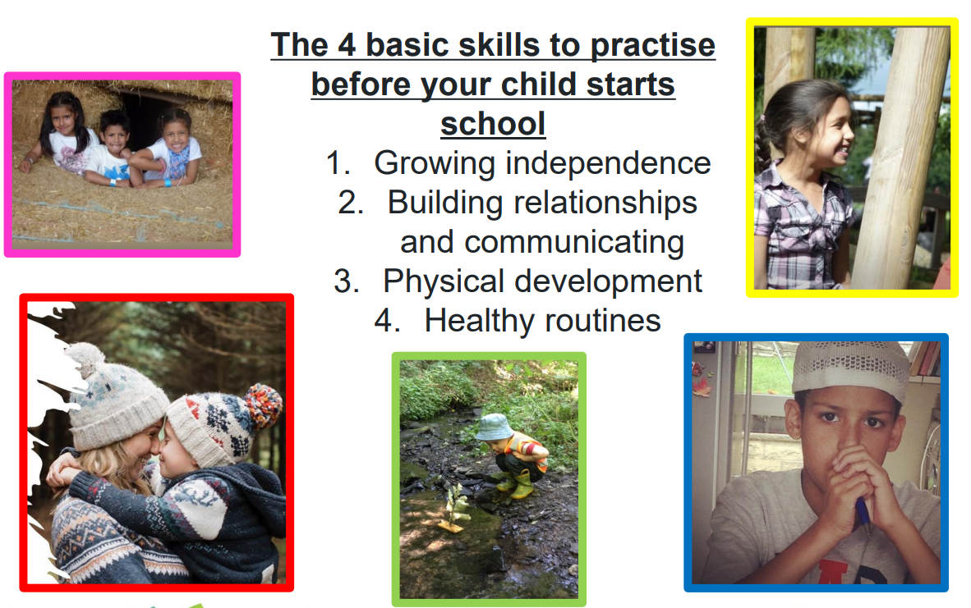

Slide 15
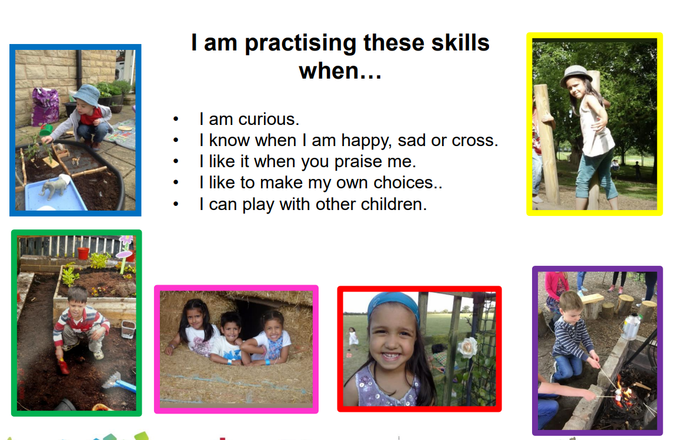

Slide 16
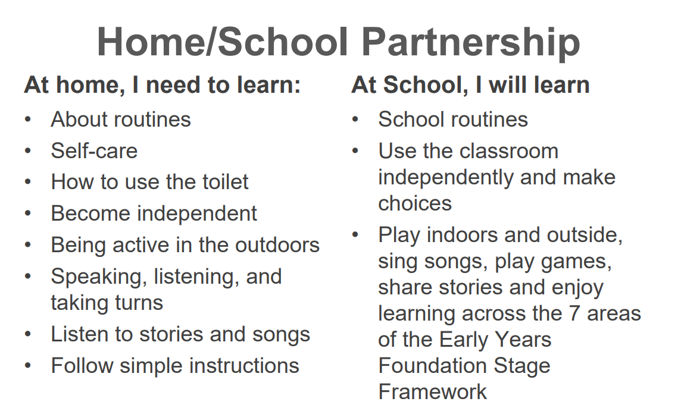

Slide 17
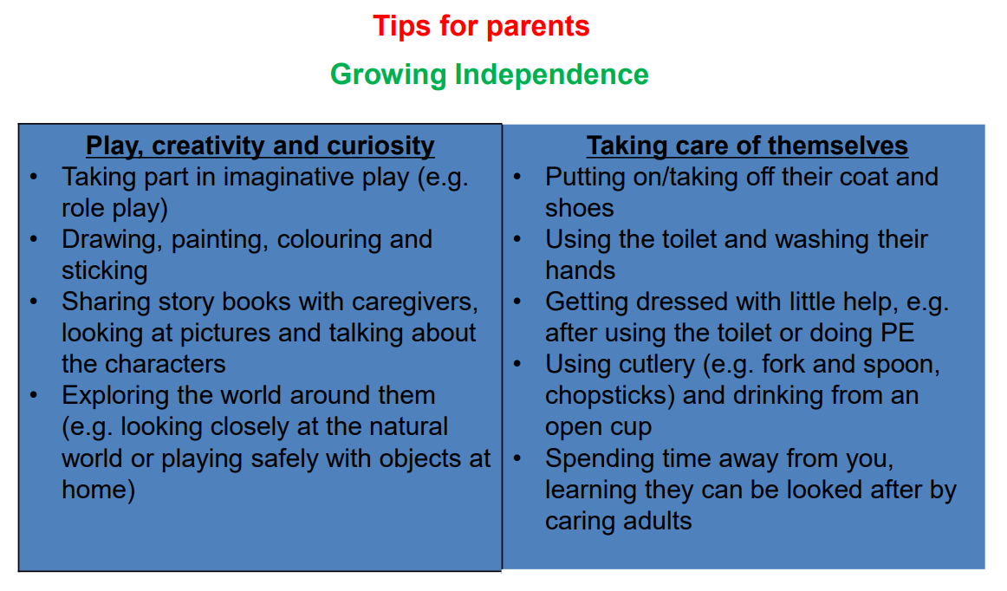

Slide 18
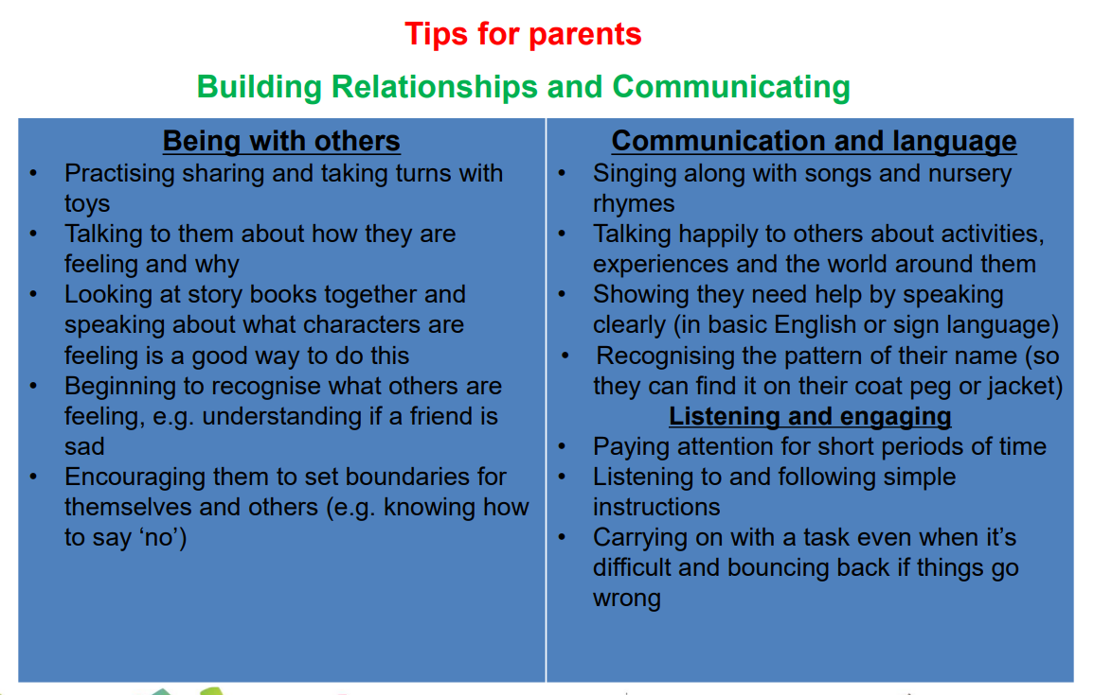

Slide 19
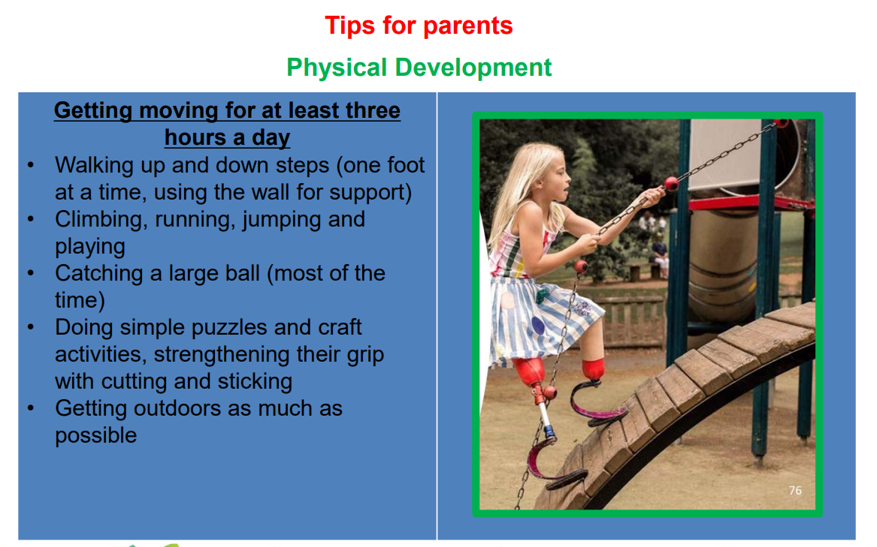

Slide 20
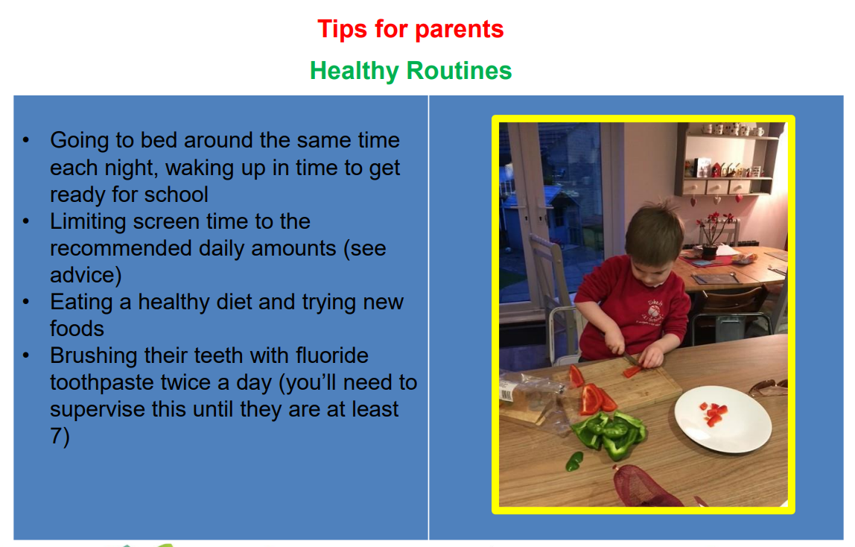

Slide 21


Slide 22


Slide 23
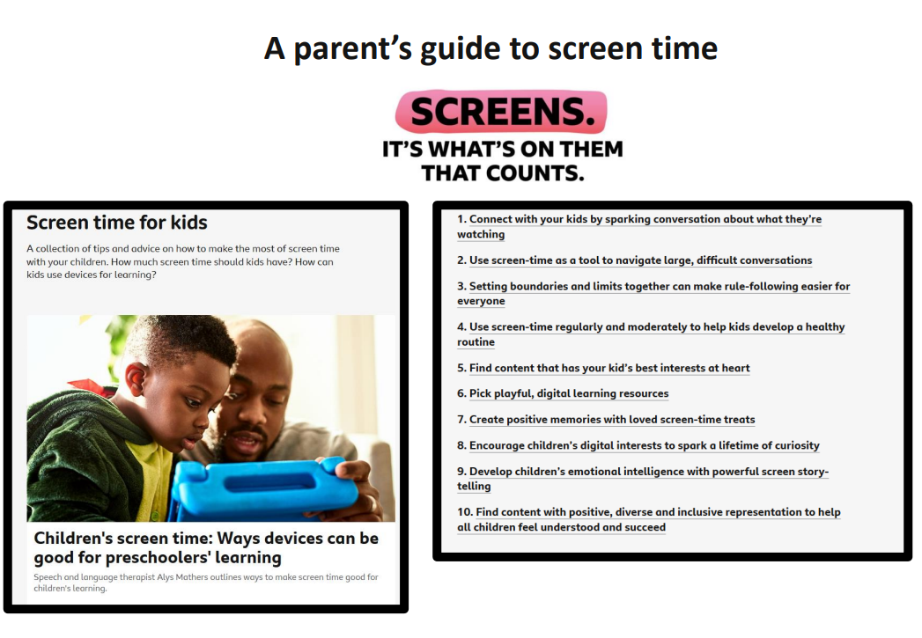

Slide 24
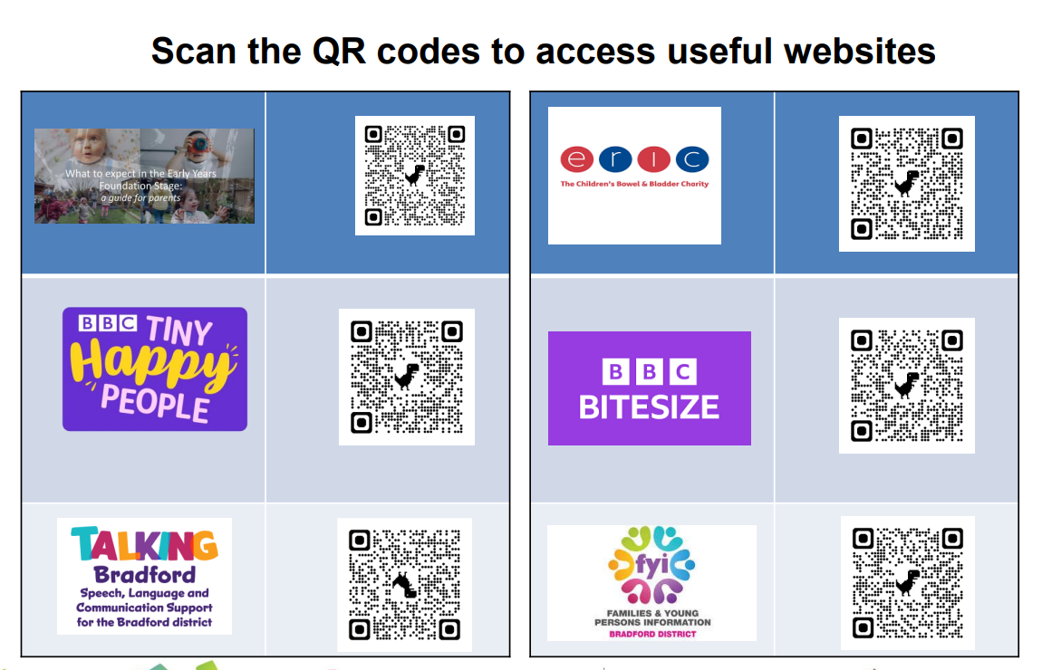

Slide 25
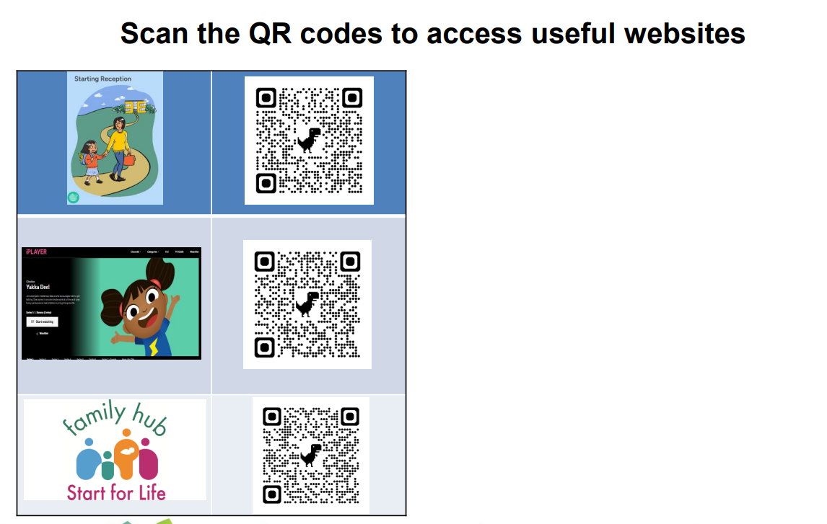

Slide 26

INCLUSION

Slide 27
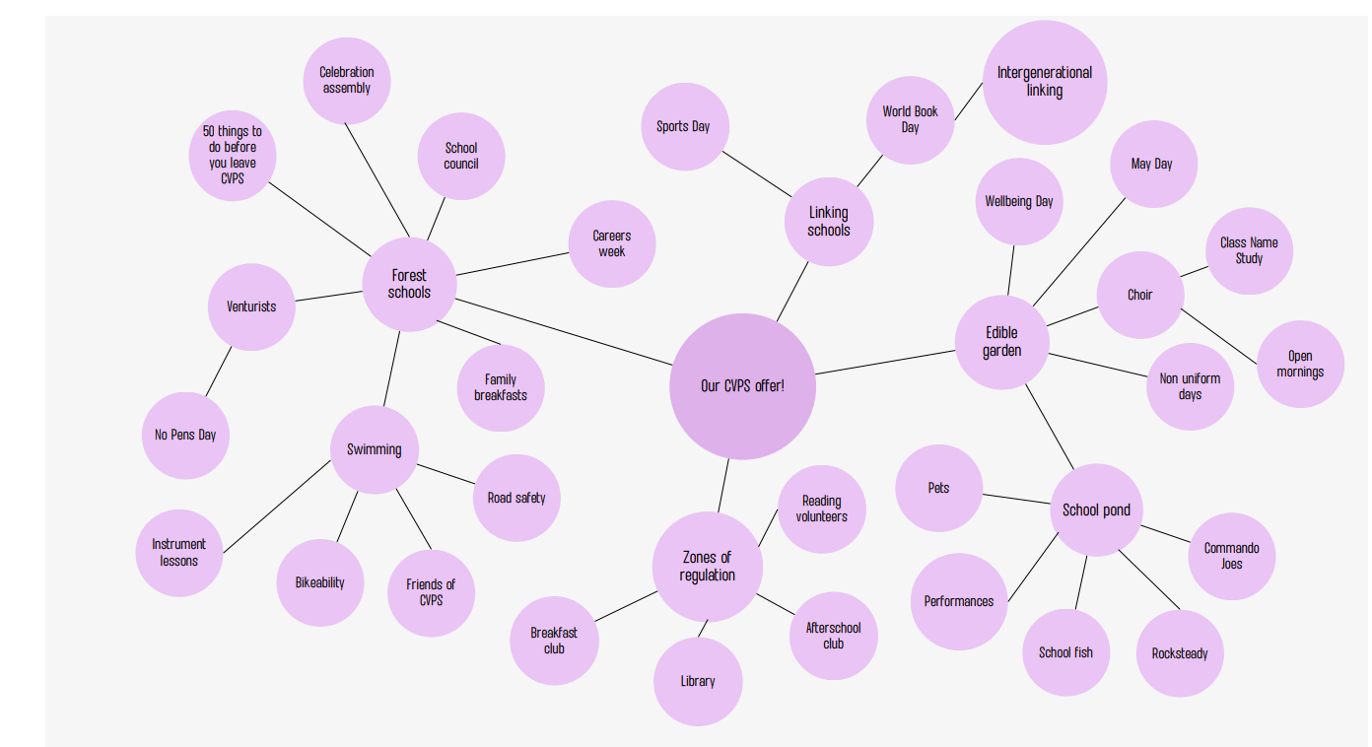

Slide 28
OFFICE
Our office opens from 8am until 4pm. Here are some things we can help you with;
Arbor- An email for Arbor will go out on second day of school with details on how to set this up. If you already have a child these accounts can be linked. We use this for any communication such as:
Attendance
Newsletters
Events happening in school
School trips
Booking parents evening.
Consent forms
Updates from teachers.
Parent pay – we are a cashless school and all payments to be made via parent pay for things such as trips, events, breakfast club and afterschool club.
A letter will be sent home with your child on the second day of school with instructions on how to set up your account.
Breakfast club - Breakfast club starts at 7.45 until school starts, the children can have breakfast here and have a range of healthy options to choose from. The children get to enjoy games and colouring before starting school.
To book breakfast club you have to book 3 or 5 days via parent pay paid in advance the term before.
Care club - this runs Monday to Thursday from 3pm until 5pm and includes a light snack/tea. This can be booked for two or 4 days per week via parent pay paid in advance the term before.
Applying for Free school Meals- Every child gets free school meals up to the end of year 2. There is also a form to check your eligibility for free school meal funding, please can this be completed and returned, we are happy to do the checker for you.
If you require any further help please don’t hesitate to ask. 😃

